Slide 1
Digit Control during Object Hand-over
Eric Chang
ASU/NASA Space Grant Intern
04/10/2014

Slide 2
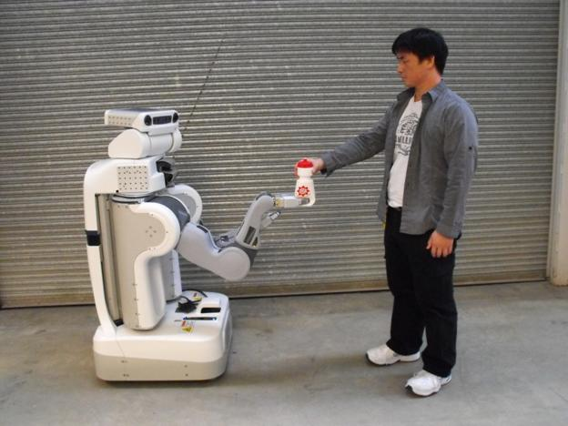
Background
Object hand-overs are common in activities daily living
Hand-overs are important for assistive robotics or upper limb prostheses
Visual feedback is not always available

Slide 3
Current Technology
Chan, Wesley Patrick (2012). A human-inspired controller for robot-human object handovers: a study of grip and load forces in handovers and the design and implementation of a novel handover controller. M.A.Sc.

Slide 4
Goal: Understand Human-human object hand-overs to design human-inspired controllers for robots

Slide 5
4.90
Test object designed to mimic iPhone 5c
ATI Nano17 6DOF load cells at each grip plate
Test object and subjects’ thumbs tracked in 3D using Vicon motion capture system
0.35
5.00
0.37
105 grams

Slide 6
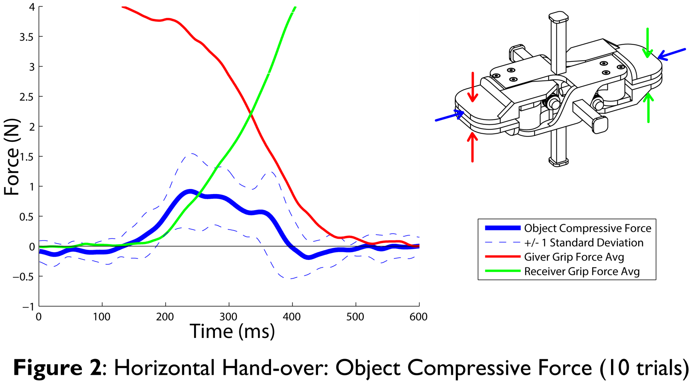
Object Compression Representative Horizontal Hand-over dataset (10 trials)

Slide 7
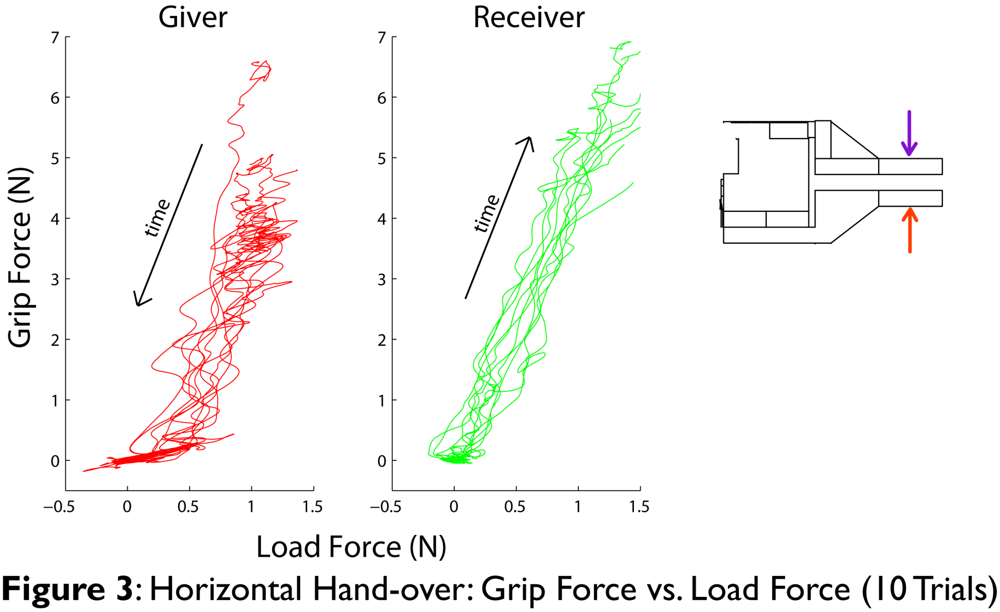
Linear Grip Force vs. Load Force Ratio Representative Horizontal Hand-over dataset (10 trials)
F_{z, top}
F_{z, bottom}
Load Force = F_{z, bottom} - F_{z, top}

Slide 8
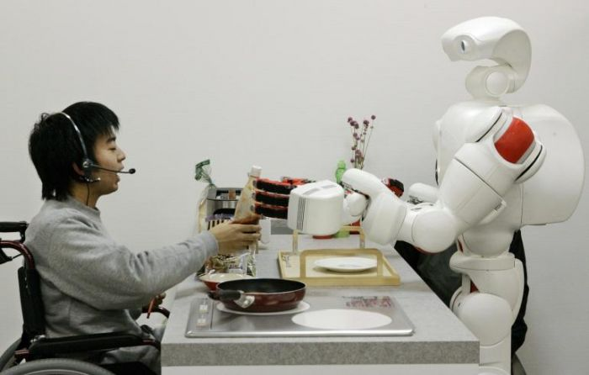
Future Work
Investigate robustness of findings with larger subject population and other test object properties
Design controller for human-robot and robot-robot hand-over tasks that use principles from human studies
Fingertip shear forces
Grip force vs. load force ratios

Slide 9
Acknowledgements
Dr. Veronica J. Santos & ASU Biomechatronics Lab
National Science Foundation Grant #1208519
ASU/NASA Space Grant Program
Barrett, The Honors College at Arizona State University

